Slide 1
Design of a JavaScript connecter to a leap motion controller
Padraic Wade

Slide 2
Outline of the project
To design a way to map motion controls to our ruby on rails d3.js dashboards at work.
We design bespoke dashboards for clients. Would be great to get even simple motions working accurately.
Started with some basic applications and hit major issues.
Hit quite significant accuracy issues, libraries and deprecation.

Slide 3
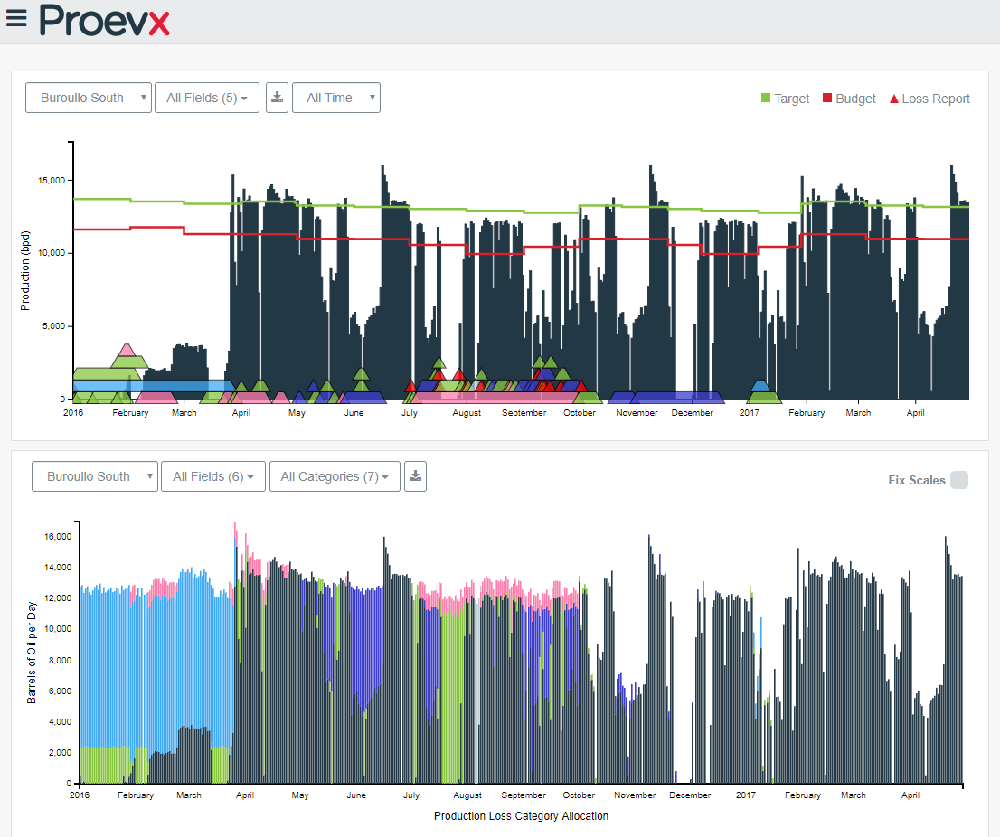
Dashboard page
To allow for the redraw element in D3 to be mapped to the leap motion controllers.

Slide 4
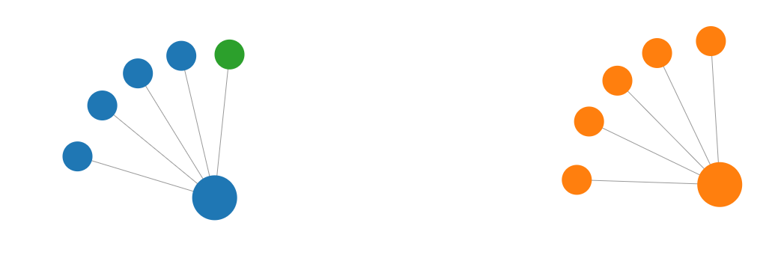
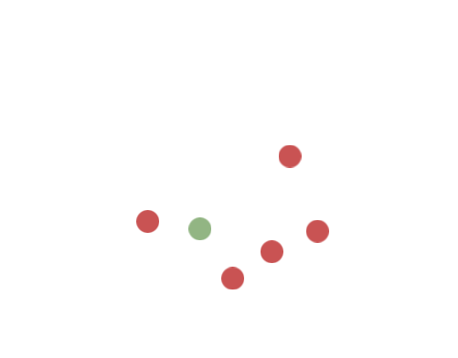
Simple demo
Started off with a simple demos to show off d3 and leap motion js. Map all the motions coming from the json to different floating points.

Slide 5
Problems with the leap JS package
And there was lots..
Deprecated & missing libraries.
https://github.com/leapmotion/leapjs complied sources aren’t available anymore as the package is deprecated. Most examples are now offline.
Newer versions of the windows app for talking to the leap motion also aren’t compatible anymore. Need to use an older version from 2016 to get it working correctly.
Hand and gesture mapping unless in perfect conditions were awful.

Slide 6
The way leapmotion renders pointables
Its pointless (ba dum tiss)
Main issue with leapmotion.js is the way it renders pointables. https://developer-archive.leapmotion.com/documentation/javascript/api/Leap.Pointable.html#Pointable.stabilizedTipPosition
It can't tell exactly where pointable really is and keeps jumping around like crazy.
So had to abandon mapping to our dashboards. Designed a simple looking game example to explain the issue instead.

Slide 7
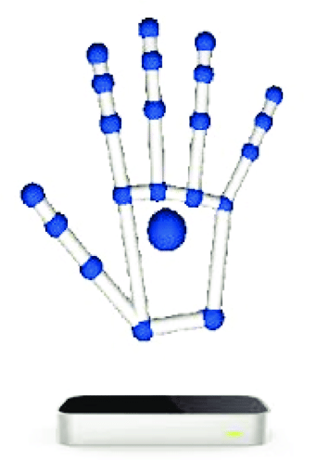
Quick Diagram to explain
Add caption directly on to solid colour parts of image

Slide 8
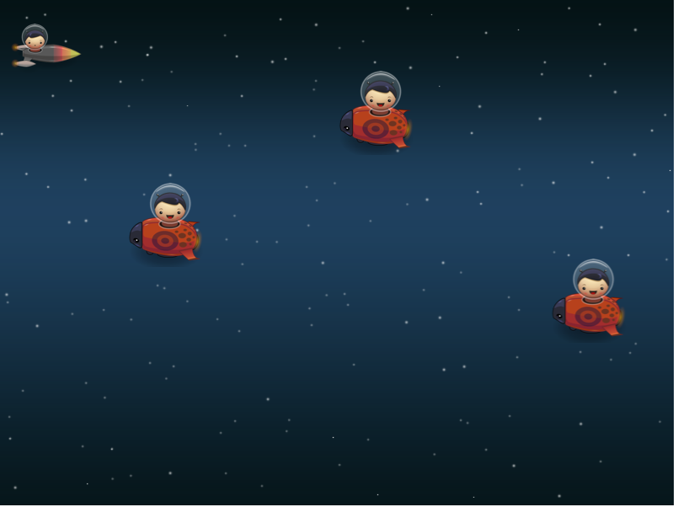
Main game
Hosted at https://elegant-easley-b7790e.netlify.com/
Simple game that maps sprites and background to a gaming engine and an attempt to stabilise the pointable calls.

Slide 9
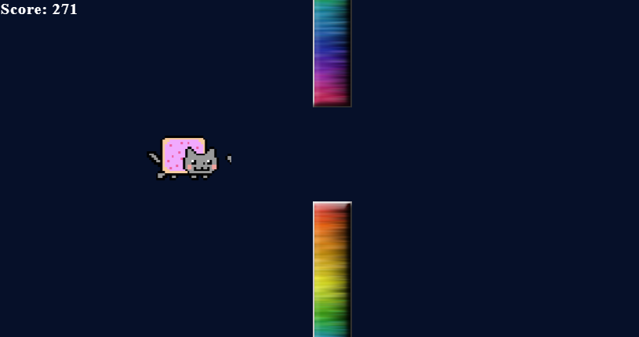
Proper game
Nyan cat, flappy bird stuff with a gaming engine (quintusJS).

Slide 10
Learnings and take away’s
Not something we plan to use in work for anything requiring accuracy.
Debugging JavaScript errors were difficult (mostly just returned nulls for anything incorrect).
Unless your using the newer version with vr headset its difficult to use.
Any questions?

